Slide 1
3G Offers Wireless Broadband Today
May 2009

Slide 2
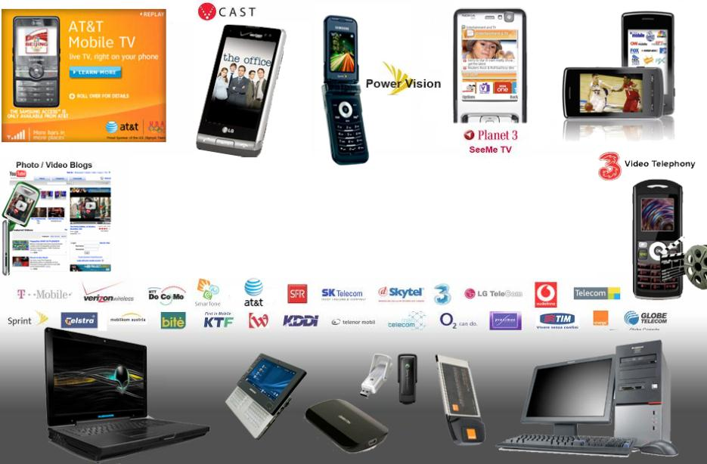
3G Offers Mobile Broadband Today
Business users and consumers can today browse the Internet or send and receive e-mails using HSPA-enabled notebooks, or using HSPA modems including USB dongles, as well as send and receive video or music using their 3G/HSPA phones…GSA Press Release, March 2009
..the number of Mobile Broadband (HSPA*) connections in Indonesia has surpassed the number of fixed broadband connections. …GSMA Press Release, April 2008
“In just over two years, we have taken our world leading network from peak network speeds of 3.6Mbps to 21Mbps and today we are launching the world’s first commercial 21Mbps peak-rated modem – more than three times faster than devices currently in market,” …Mr Trujillo, CEO, Telstra, February 2009.
All trademarks, names of other companies, logos, products and services may be the property of their respective owners

Slide 3


















































3G Offers Fixed/Nomadic Broadband Today
All trademarks, names of other companies, logos, products and services may be the property of their respective owners

Slide 4
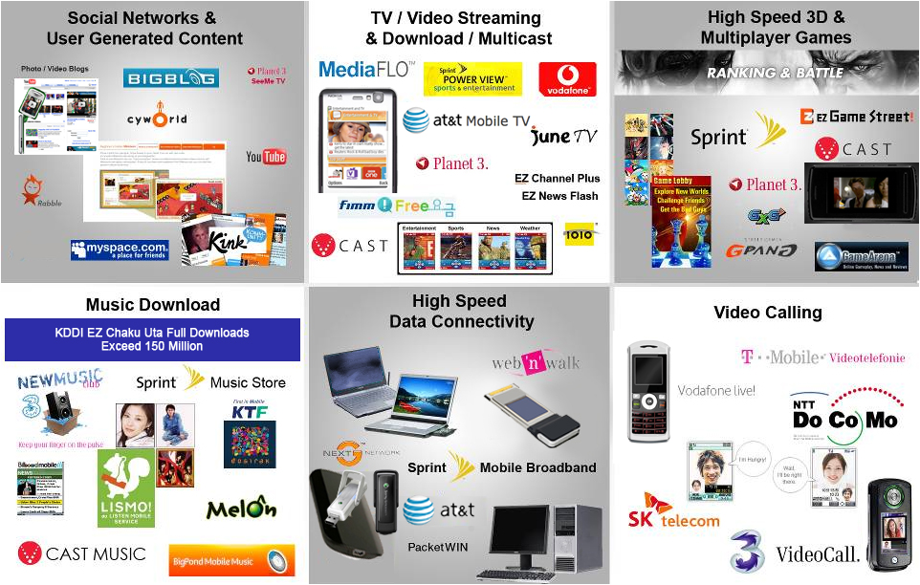
3G Offers a Wide Range of Services
KDDI EZ Chaku Uta Full Downloads Exceed 200 M ( As of May 2008)
All trademarks, names of other companies, logos, products and services may be the property of their respective owners

Slide 5

More Than 1.5 Billion People Have Access to Over 535 3G Networks Today
3G
750+ Million 3G subscribers
Over 210 Million HSPA and EV-DO subscribers
> 535 Commercial 3G Operators in 152 countries
> 245 HSDPA (> 65 HSUPA) > 260 WCDMA
> 105 EV-DO (> 55 Rev. A) > 275 CDMA2000 1X
Sources: Wireless Intelligence, March 2009; CDG, Global Mobile Suppliers Association: as of March 2009
Notes:
- Global ubiquity of 3G rollout

Slide 6
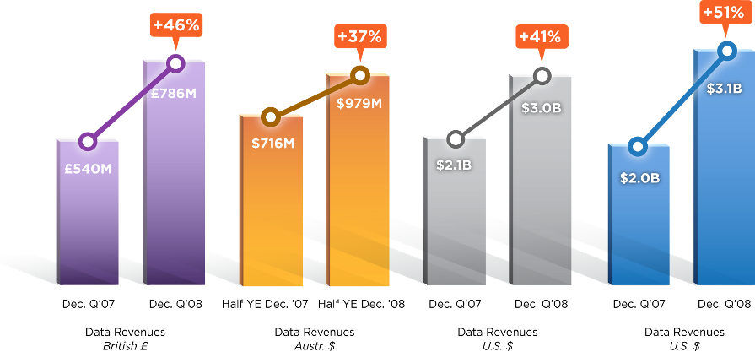
3G Operators Showing Strong Data Revenue Growth Globally
Sources: Verizon, Vodafone Group, AT&T, Telstra.
Notes:
“Non-messaging revenue is up 40% Y/Y driven by Vodafone “live” and laptop connectivity.”
Arun Sarin, Vodafone CEO
And the operators are investing because they're seeing the return. You can see the charts here, the growth rates are very high on their data services. As you saw in that previous chart, the voice services, the usage is not going up that much. So where is their growth coming from? The growth is coming from data services, from mobile broadband and from providing multimedia and all sorts of other kinds of services to the device.
And a lot of times in the past people talked about wireless data, they meant text messaging or SMS, short message service. But if you look here on the Telestra chart, that's the operator down in Australia, that's all WCDMA. It's running a WCDMA network. They've now seen that their revenues from non-text data services have now outstripped the revenues that they had, and they're growing extremely rapidly, as you can see on that chart. So the operators are excited, the consumers are excited. Data is happening.

Slide 7
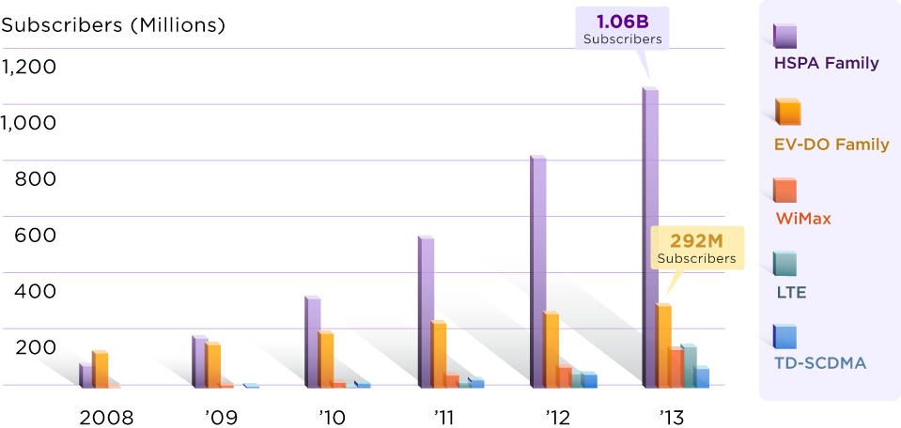
3G Will Drive the Majority of Mobile Broadband Connections Well Into the Next Decade
3G will enable 80% of mobile broadband subscriptions in 2013
Sources: HSPA Family and EV-DO Family - Average of SA, WCIS+, WI, In-Stat and ABI. WiMax - Average of ABI (Q3 2008) and In-Stat (June 2008). LTE - Average of SA,n-Stat and ABI. TD-SCDMA - Average of SA, WI, In-Stat and ABI. Note: Forecasts from In-stat and WI are available only till 2012. Forecasts from WCIS do not have data for 2008. Does not include any 1X and WCDMA subs.

Slide 8
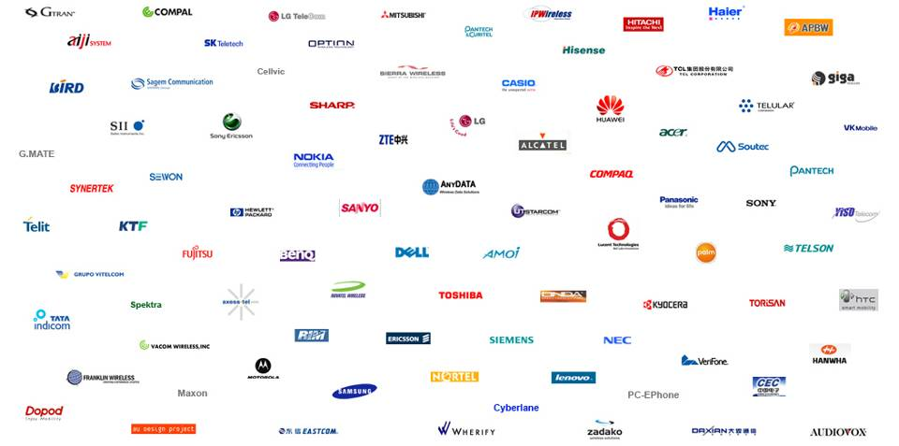
Many Vendors in a Competitive 3G Ecosystem
107 EV-DO vendors; 94 HSPA vendors
Source: CDG
All trademarks, names of other companies, logos, products and services may be the property of their respective owners

Slide 9
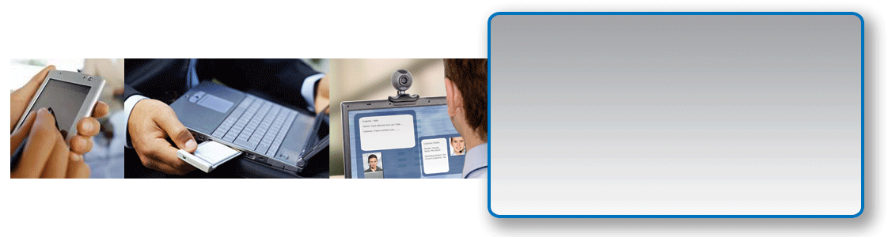
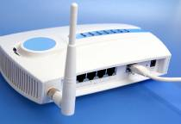






3G Offers Great Diversity Across All Segments
> 525 EV-DO devices (100 Rev A ); > 1400 HSPA devices (240 HSUPA)
All Market Segments
Mobile/Nomadic/Fixed
Enterprise
Ethernet-Class Performance
Consumer
Cable/DSL-Class Performance
Handsets and PC cards
Consumer Electronics
Portable/Mobile Computing Devices
Embedded laptops
Desktops
All Device Segments
Sources: CDG,& GSA. – as of March 2009
Notes:
Ethernet class performance is the performance similar to E1/R1 type connections
Cable/DSL class performance is performance similar to Residential Cable/DSL/Fiber-to-Home type of connection.

Slide 10
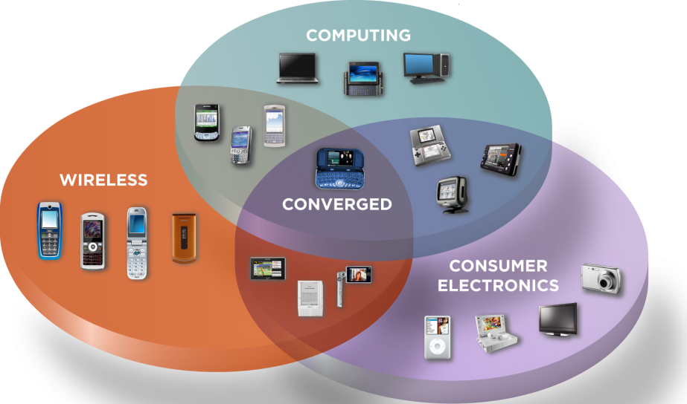
3G Enabling New Devices in Mobile, Computing and CE Device Categories

Slide 11


Scale, Number of Sites Are Biggest Cost Drivers
Scale has significant impact on device cost
Volume accounts for cost difference between comparable WiMAX and 3G devices
Most device costs are not air interface-specific!
Most non-modem components in 3G and WiMAX devices are the same
WiMAX nomadic devices will likely need to roam on 3G networks (multimode devices required)
WiMAX modem will be additional cost on top of that required for 3G access
Number of cell sites is primary driver of network costs
Capital & operating expenses (e.g. backhaul, operations; network elements)
Urban deployments: capacity, spectral efficiency
Rural deployments: spectrum, link budget
VoIP and data capacity
Notes:
Clean up – do network costs belong here?

Slide 12
3G Device Cost Declining as Scale Increases
CDMA2000 Global Device Forecast
CDMA2000 Handset Costs Decline to US$17
Sources: Average of ABI (Q4’08), Yankee (Q4’08), Gartner (Dec’08), IDC (Dec’08), IMS (Dec’08), iSuppli (Oct’08)
WCDMA/HSPA Global Device Forecast
WCDMA Handset Costs Decline to US$58
Sources: Average of ABI (Q4’08), Yankee (Q4’08), Gartner (Dec’08), IDC (Dec’08), IMS (Dec’08), WCIS+ (Q1’09), In-Stat (Oct’08), iSuppli (Oct’08), SA (June’08)

Slide 13
Minimizing Number of Sites Is Important: 3G Network Expense Breakdown Example
All network costs should be considered when comparing alternatives
All major costs increase with number of sites; most are not Air Interface-specific
Fixed/Nomadic Voice + Data Network Example
Capital Expense
600 MOU /Sub/Month
1000 MB /Sub/Month
Notes:
Urban morphology (10K Pops/SqKm)
Wireless penetration: 50%
Operator market share: 25%
Local call termination charges and long distance transport costs are not included in the network expense calculations
Spectrum available: 2X10MHz @ 800MHz
Operating Expense
Number of sites drives both OpEx and CapEx

Slide 14
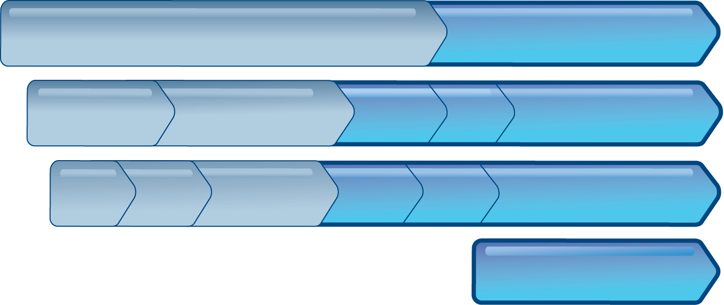
A Strong 3G Evolution Path
Excellent Mobile Broadband Today Voice and Full Range of IP Services
Enhanced User Experience
Improved voice and data capacity
CDMA2000
1X
1x Advanced
Rel. 0
Rev. A
Phase I
Phase II
EV-DO
EV-DO Rev. B
DO Advanced
Rel-99
Rel-5
Rel-6
Rel-7
Rel-8
Rel-9 & Beyond
WCDMA
HSPA
HSPA+ (HSPA Evolved)
LTE Leverages new, wider and TDD spectrum
Rel-8
Rel-9
Rel-10
LTE
LTE Advanced
2009 — 2010
2011+
Created 01/30/09
Backward and Forward Compatibility Cost-effective upgrades that leverages existing assets

Slide 15

3G Backward/Forward Compatibility Entails Lower Long-term Cost
3G operators can phase deployments, grow coverage with market demand while fully leveraging their initial investment
Existing operators can leverage their networks to minimize deployment costs
Multimode devices offer flexibility for various coverage scenarios
Evolutions of 3G networks compatible with deployed devices
Backward compatibility avoids costly mandatory device replacement
Proven 3GPP and 3GPP2 processes and track record assure backward compatibility
Future 3G devices compatible with deployed networks
Operators’ choice of devices not impacted by their network upgrade strategy

Slide 16
Conclusions
3G’s device scale provides considerable cost and diversity advantages over WiMAX, enabling more low-cost devices
3G overall network costs are lower than WiMAX
Network expenses are dominated by number of sites
3G offers operators flexible fixed and mobile broadband; they can offer a wide range of affordable voice & data services today
3G systems are evolving and provide class-leading OFDMA & MIMO solutions
Notes:
Give some color?

Slide 17

Thank You

Slide 18
声明：
所有的版权属于原有公司，文件均来自公开渠道
此文件仅供学习使用，任何人不得进行以此为商业目的的行为
如有疑问，请立即删除
学习世界五百强和咨询公司PPT课程请访问如下网站搜索：“司马懿”
百度传课：司马懿PPT学校
https://www.chuanke.com
网易学堂：司马懿PPT学校
https://study.163.com
知乎： 司马懿PPT学校
https://www.zhiu.com

